Slide 1
EMT by Notch signaling and TGF β signaling
Cell B: Notch on : Hes 1 high
Notch Receptor
Notch Ligand
Ligand binding
γSC
Notch Receptor *
CSL
ICD
NGN2
CSL *
HES1
SLUG
ASCL1

Slide 2
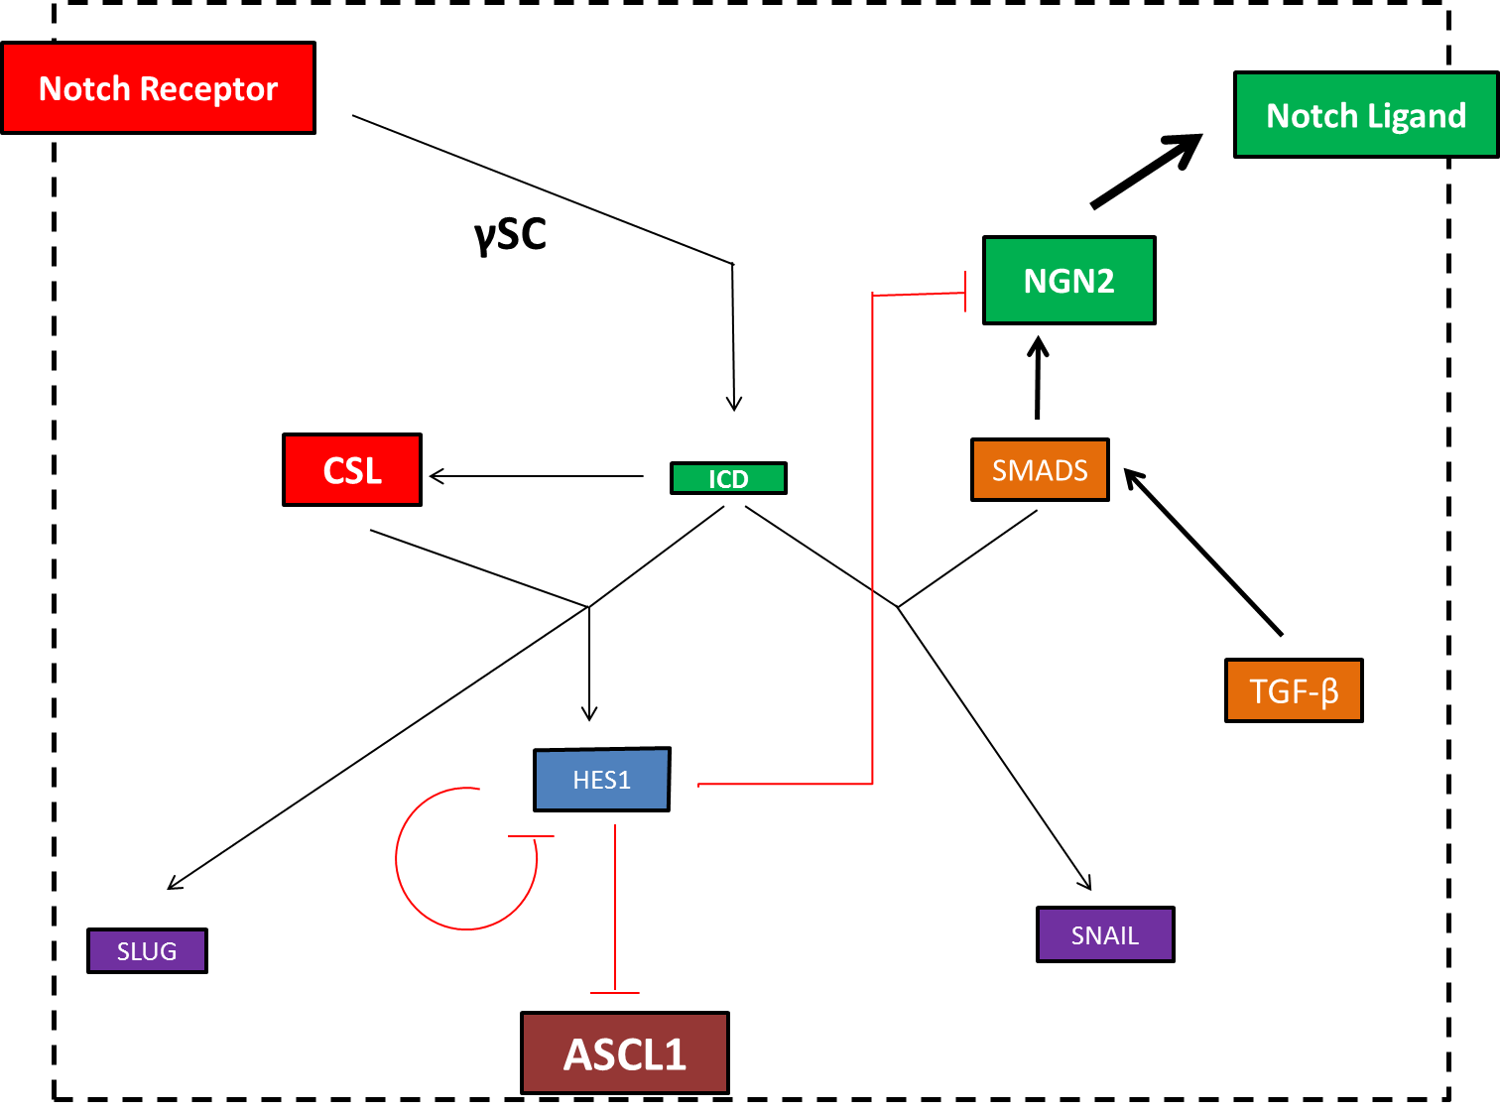
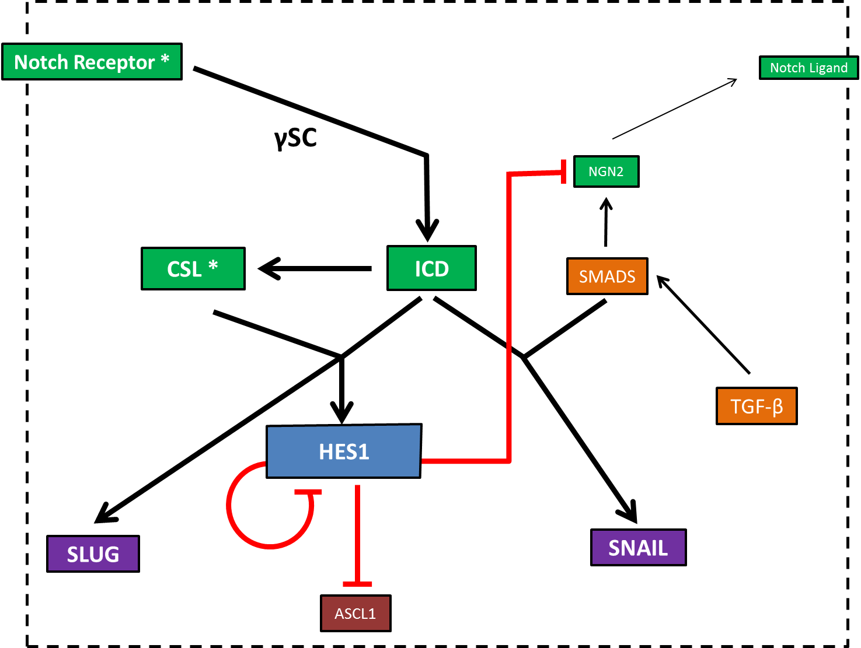
Cell A: Notch off: Hes 1 low
Cell B: Notch on : Hes 1 high

Slide 3
Notch Ligand | DLL,Jagged, etc. Expressed on cell membrane, activates Notch signaling in neighbouring cells
Notch Receptor | Expressed on cell membrane, binds to receptor on neighbouring cell, gets cleaved to activate Notch signaling
Notch ICD | Notch Recpeptor Intracellular Domain: Main signaling mediator. Product of cleavage of Notch Receptor by γSC, goes to the nucleus to activate signaling
Hes1 | (hairy and enhancer of split-1) mammalian TF under control of Notch
CSL | CSL (CBF1, Suppressor of Hairless, Lag-1): another TF in Notch pathway, co-activator of Notch signaling, It suppresses transcription in absence on Notch activation, and is activated by Notch
ASCL1 | (Achaete-Scute Family BHLH Transcription Factor 1): TF that’s expressed in endothelial and epithelial tissue
SLUG | E-cadherin repressors that promote EMT, activated by Notch and CSL
SNAIL | E-cadherin repressors that promote EMT; activated synergistically by Notch and TGF-β signaling
TGF-β | Another signaling pathway, though to interact with Notch, promotes expression of Notch ligand
γSC | γ Secretase complex : Cleaves Notch Receptor to produce the free ICD that travels to the nucleus and effects Notch signaling

Slide 4
Cell A: Hes 1 low: Notch off
Notch Receptor
Notch Ligand
γSC
NGN2
CSL
SMADS
ICD
TGF-β
HES1
SLUG
SNAIL
ASCL1

Slide 5
Cell B: Hes 1 high: Notch on
Notch Receptor *
Notch Ligand
γSC
NGN2
CSL *
ICD
SMADS
TGF-β
HES1
SLUG
SNAIL
ASCL1

Slide 6
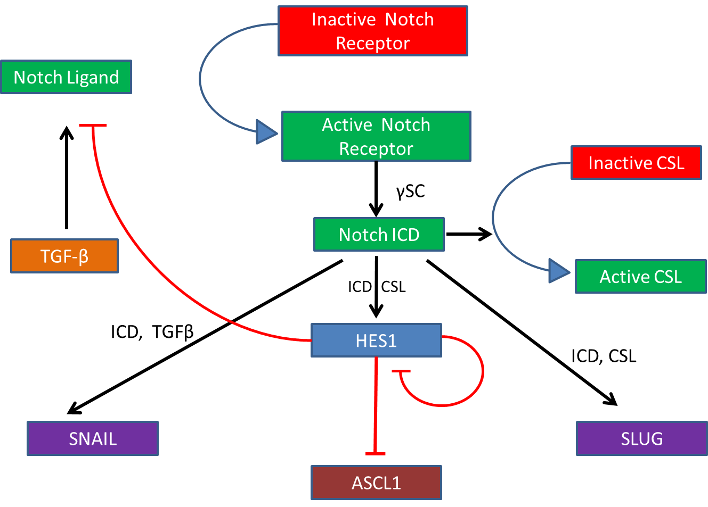

Slide 7
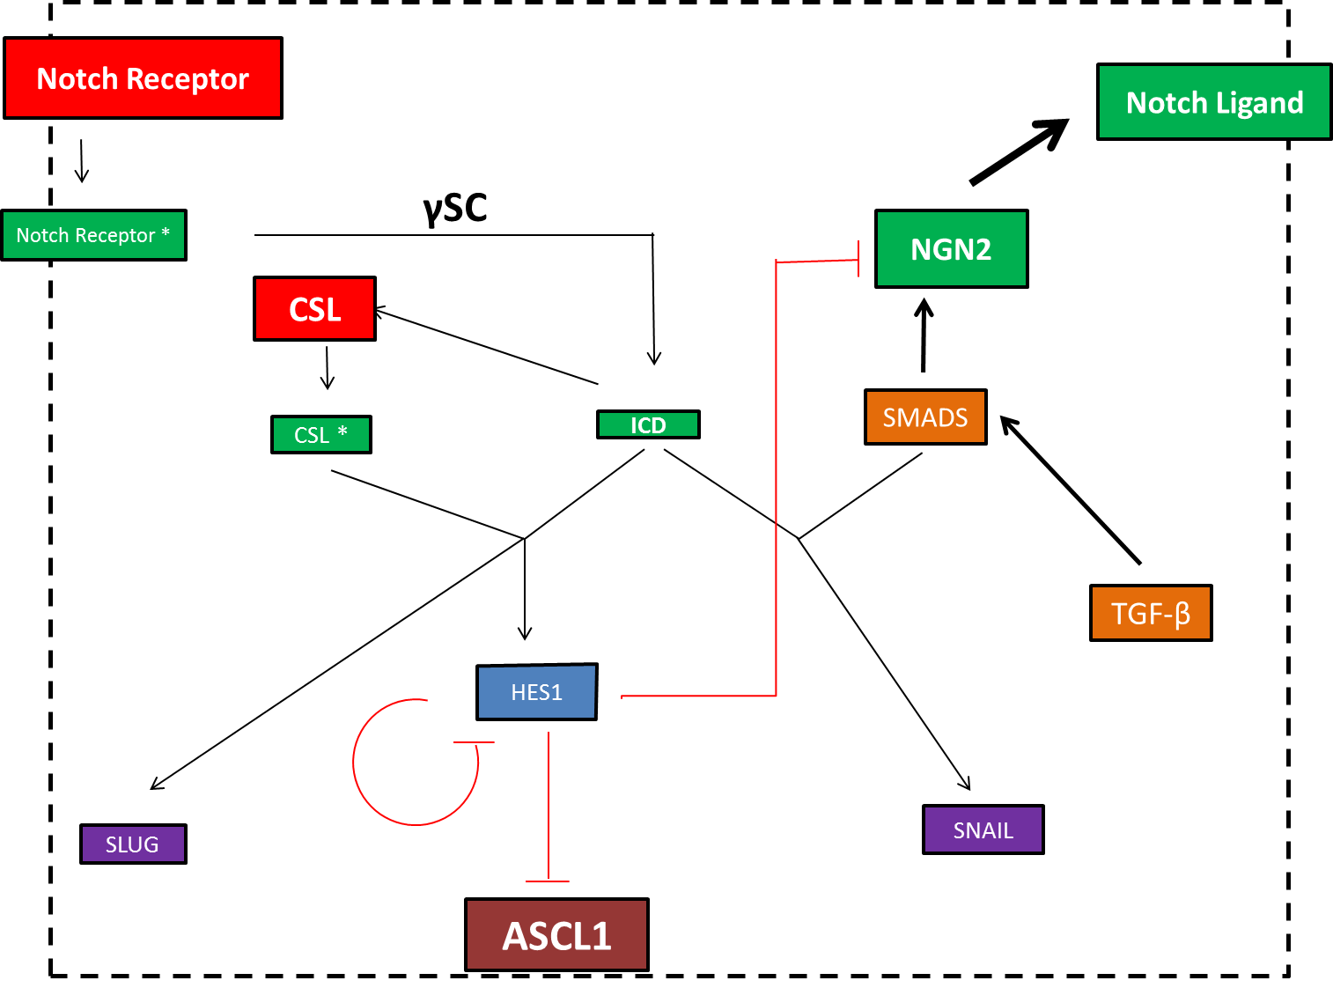
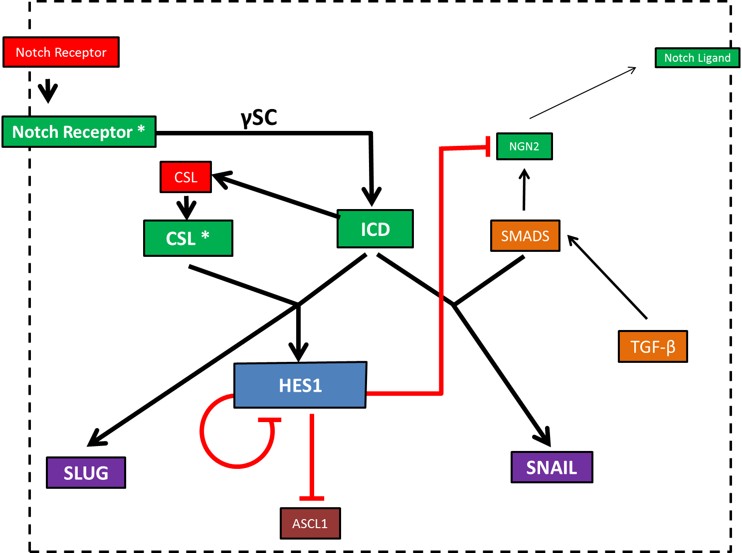
Cell A: Notch off: Hes 1 low
Cell B: Notch on : Hes 1 high

Slide 8
EMT by Notch signaling and TGF β signaling
Cell A: Notch off: Hes 1 low
Notch Receptor
Notch Ligand
Ligand binding
γSC
Notch Receptor *
CSL
ICD
NGN2
CSL *
HES1
SLUG
ASCL1

Slide 9
EMT by Notch signaling and TGF β signaling
Notch Receptor
Cell B: Notch on : Hes 1 high
Ligand binding
Notch Ligand
Notch Receptor *
γSC
ICD
CSL
NGN2
CSL *
HES1
SLUG
ASCL1

Slide 10
EMT by Notch signaling and TGF β signaling
Cell A: Notch off: Hes 1 low
Notch Receptor
Notch Ligand
Ligand binding
γSC
Notch Receptor *
CSL
ICD
NGN2
CSL *
HES1
SLUG
ASCL1

Slide 11
EMT by Notch signaling and TGF β signaling
Notch Receptor
Cell B: Notch on : Hes 1 high
Notch Ligand
Ligand binding
γSC
Notch Receptor *
CSL
ICD
NGN2
CSL *
HES1
SLUG
ASCL1

Slide 12
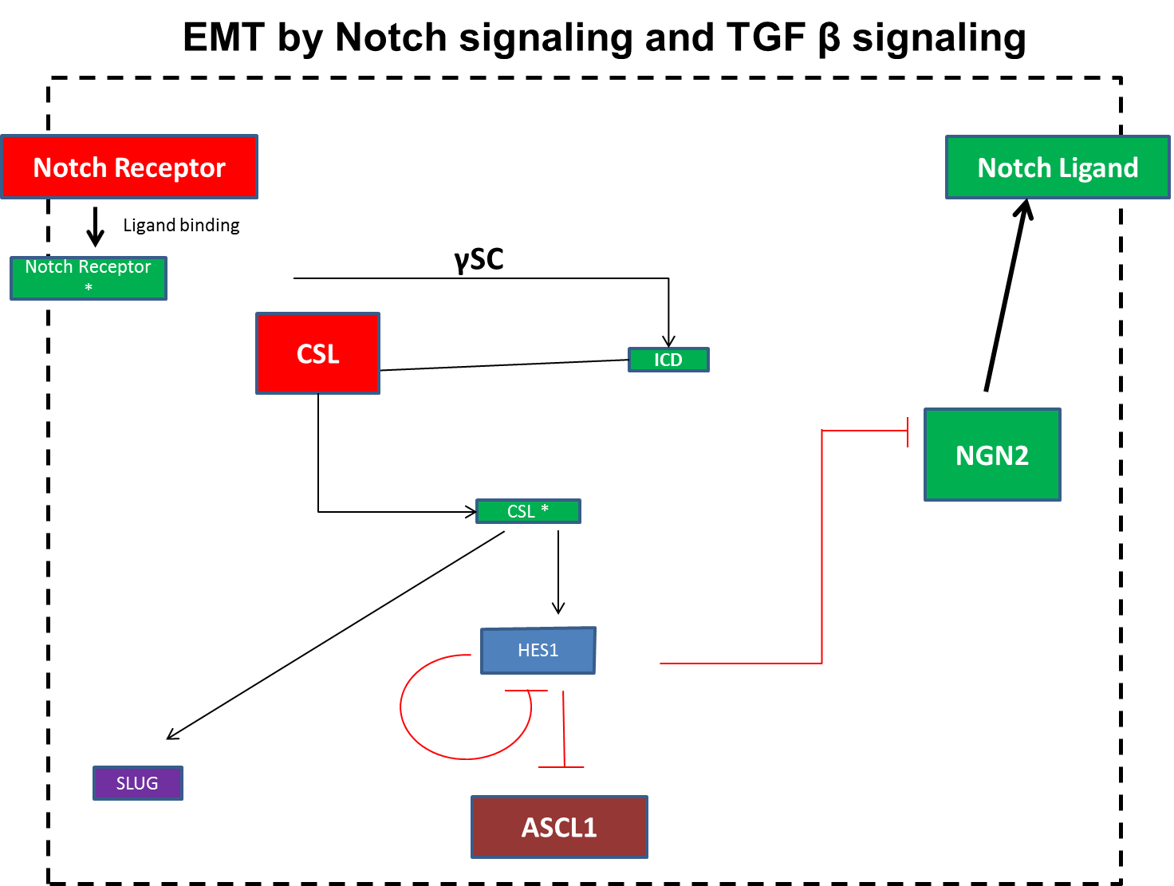
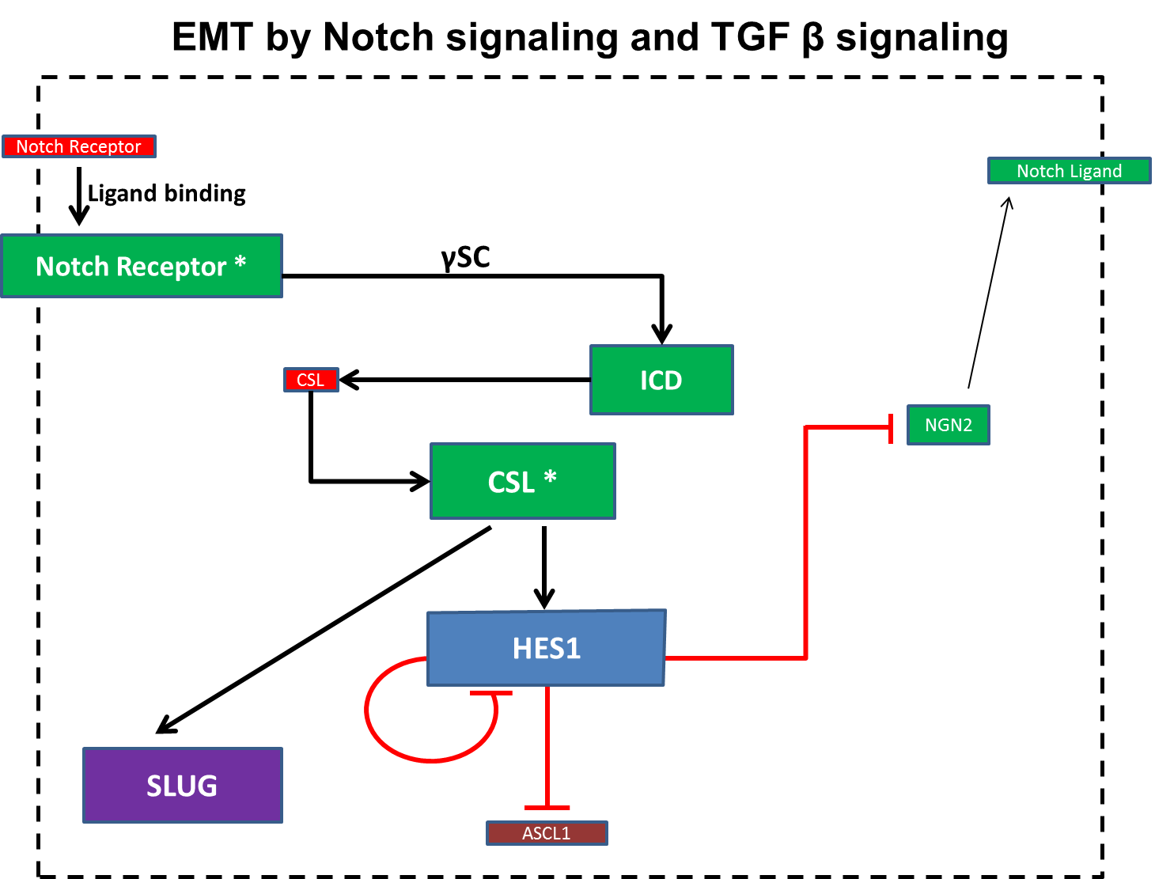
EMT by Notch signaling and TGF β signaling
Cell A: Notch off: Hes 1 low
Cell B: Notch on : Hes 1 high

Slide 13

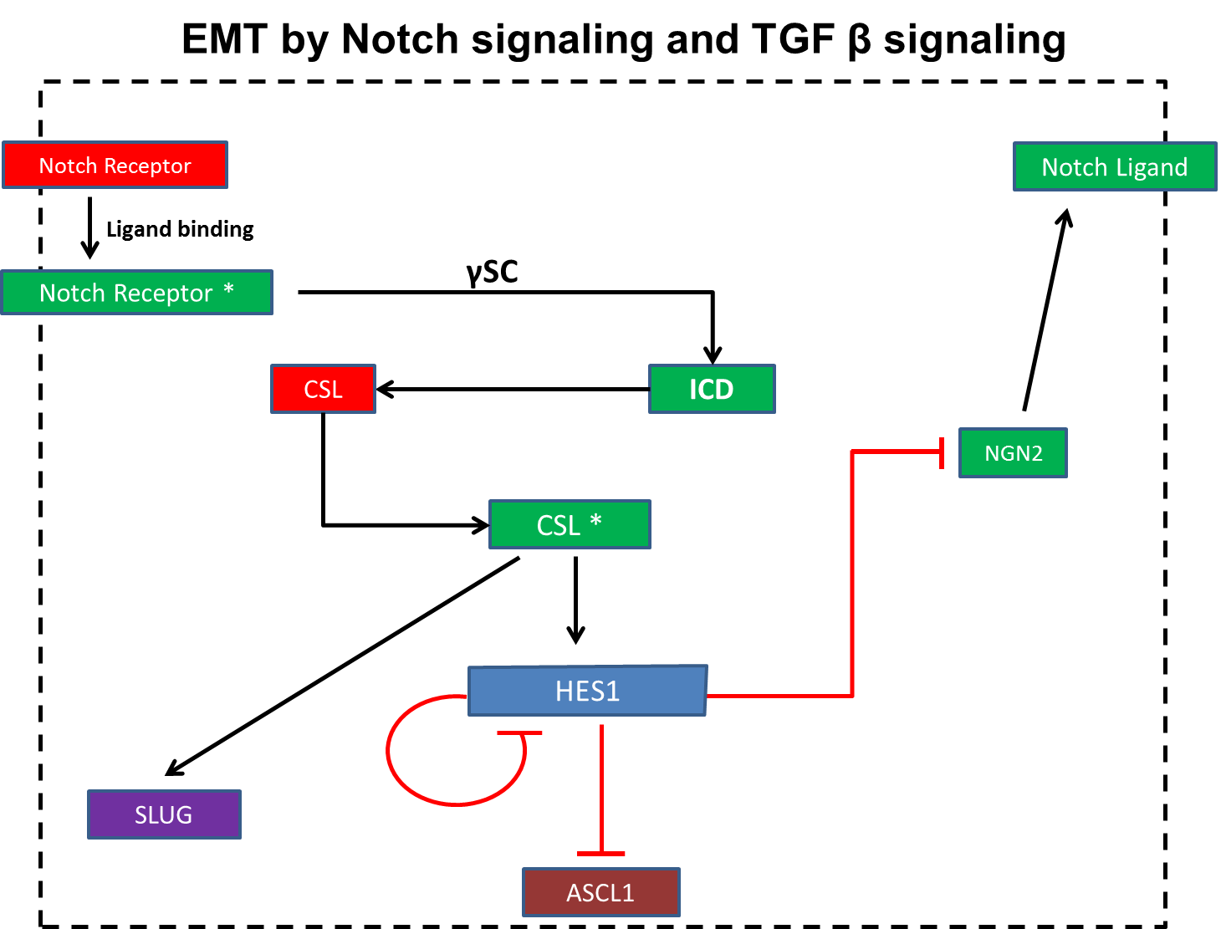
EMT by Notch signaling and TGF β signaling
Cell A: Notch off: Hes 1 low
Cell B: Notch on : Hes 1 high

